Slide 1
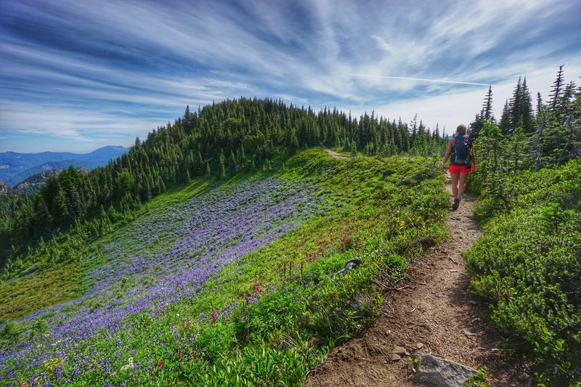
Turransky Regression Project
An assessment on public National Park trail data

Slide 2

Introduction
There are 63 sites declared by Congress as a US National Parks
National Park designation helps provide adequate protection of the area’s resources.
As new land areas are designated as National Parks, they see a surge in attendance.
More hikers means more maintenance, security etc are needed.
Knowing what draws hikers to a trail will help new areas plan accordingly

Slide 3
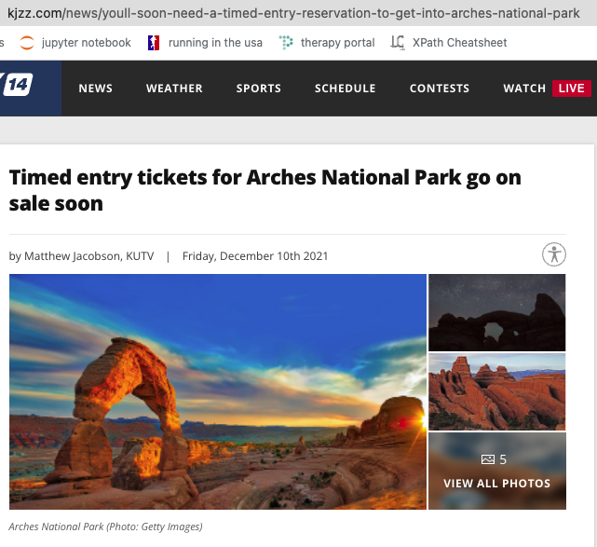
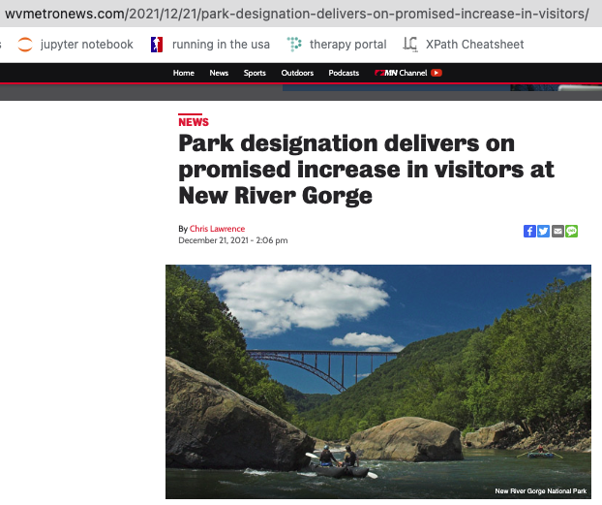
Hiker attendance is a big issue for old and new national parks!
From the above website:…”Officials promised there would be at least a 20 percent increase in traffic and visitation in the year the park designation is added. …visitor numbers have jumped well over 20 percent for 2021.”
Arches, Zion and other national parks saw such an influx in visitors during the pandemic they had to implement restrictive measures liked timed entry tickets or a lottery to do certain hikes.

Slide 4
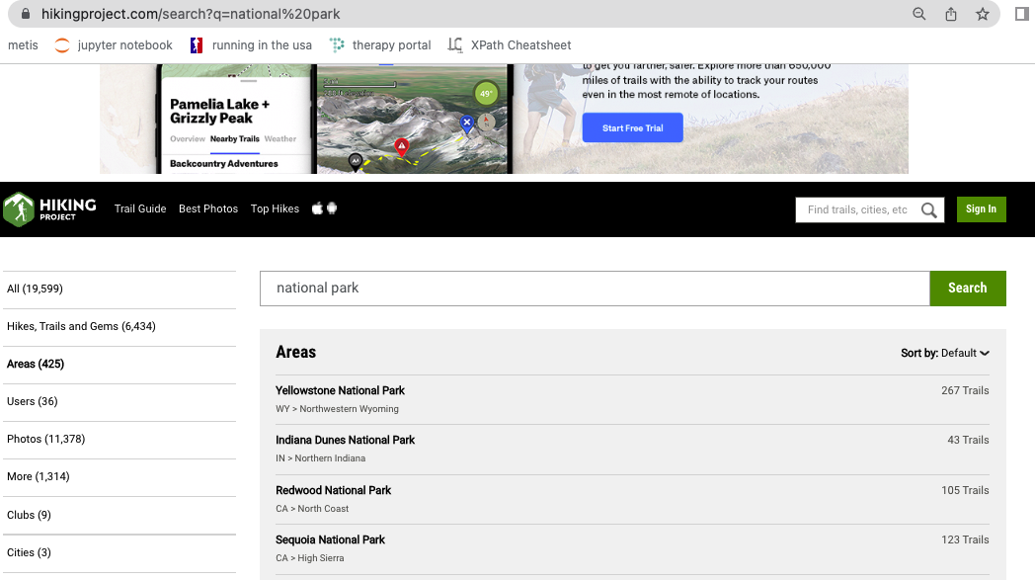
Methodology
Used Selenium to dynamically navigate HikingProject.com to get individual national park websites and websites for each trail at each national park
Used beautiful soup to parse HTML code for desired data.

Slide 5
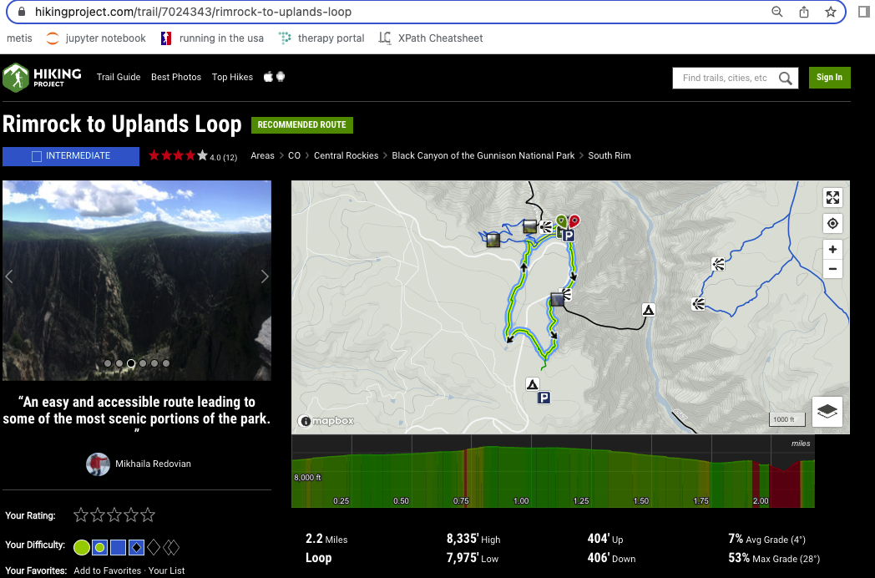
Sample trail page and some details scraped:

Slide 6
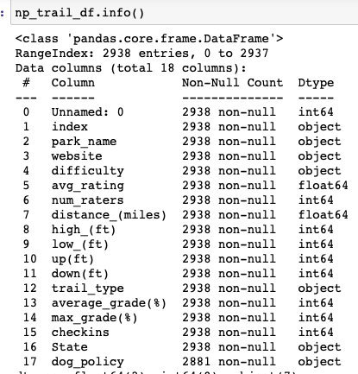
All Scraped Details
Features:
Park Name
Trail Website
Trail difficulty
Average Rating of the trail
Number of people who rated the trail
Distance in miles
High elevation
Low elevation
Distance hiker goes uphill
Distance hiker goes downhill
Trail type (loop, out and back etc)
Average grade (%)
Max grade(%)
Checkins
State
Dog policy

Slide 7
Regression Methodology Highlights
Performed Train/Validation/Test separation on model
Utilized dummy variables to assess categorical non-numeric values.
Grouped parks by regions
Measured improvements on R-Squared using stat model and Sklearn
Target was number of people who rated each trail. The more people who hike a trail, the more ratings a trail will have. Since the website did not have a ‘completed’ option this next best correlated well with our target.

Slide 8

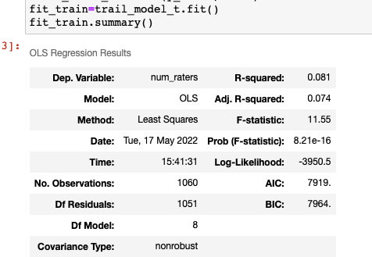
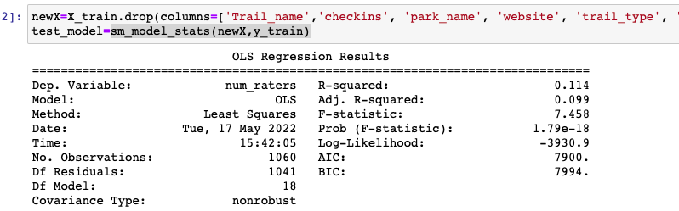
Improvements in R_squared for Training and Validation data
How it started
How it ended
Initial Train R_squared: 0.081
Initial Validate R_squared: 0.070
Final Train R_squared: 0.114 (+0.033)
Initial Validate R_squared: 0.097 (+0.027)

Slide 9
Train + validate model vs test data results
Train and Validation data combined resulted in a R_squared score of 0.119.
Running the above model on test data resulted in a R_squared score of 0.124.
Features that had the largest impact on number of raters:
Average rating
Distance
Location (Parks in Colorado Plateau region (including Zion, Grand Canyon, Arches etc) did especially well

Slide 10
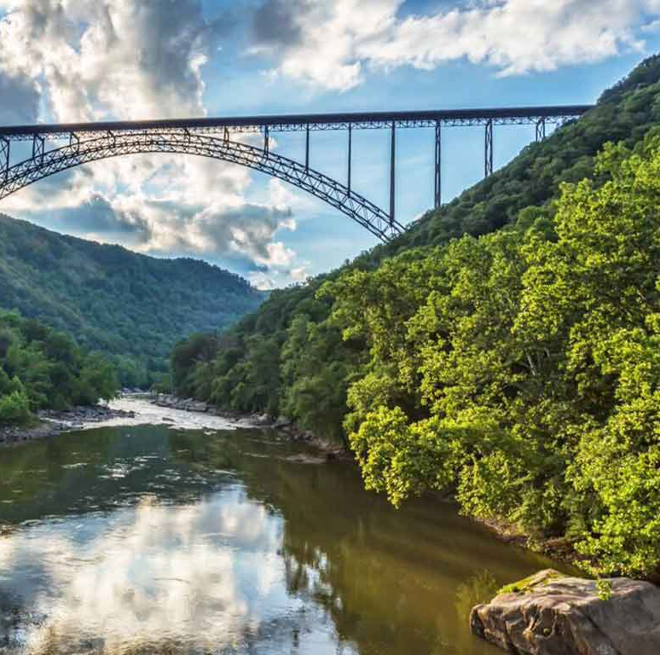
Future Model Evaluation
In December 2020, congress designated 72,808 acres of land in WV as New River Gorge National Park.
Because of how recent this happened, Hikingproject.com did not have that park on the list of National Parks.
This data could be scraped at a later time and compared against the trail model for further testing/validation of the model.

